Slide 1
Web SSH
Project created by: Ene Mircea

Slide 2
Web SSH – Description and Details
The main goal of the website is to ease the work of remote server administrators, allowing secure shell connections from any device.
Web SSH accepts key and password connections, both being encrypted with a master password and stored in a database, along with the server details.
On the front-end side, the shell is created with the xterm.js library (https://xtermjs.org/), a TypeScript component that brings fully-featured terminals to their users in the browser.
On the back-end side, the data from the SSH connection is transmitted to the front-end through WebSockets, a two-way interactive communication technology.

Slide 3
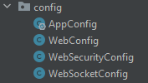
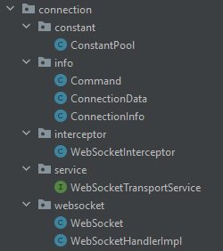
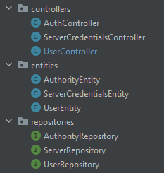
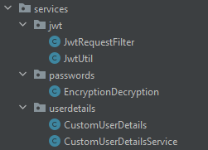
Project Structure
Spring configuration
WebSockets connection
REST APIs, DB Entities and DB Respositories
Services used (ex: JWT filter to check the JWTs)

Slide 4

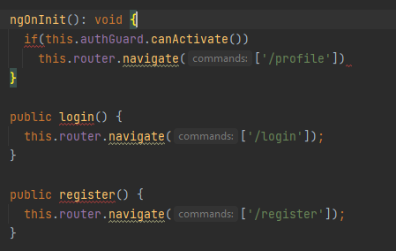
The Home Page
The home page uses a REST API to check if the user is already logged in, and if it receives 'true' from the back-end, it redirects the user to his/hers profile page. In case of 'false', it gives two options, to Login or Register.

Slide 5
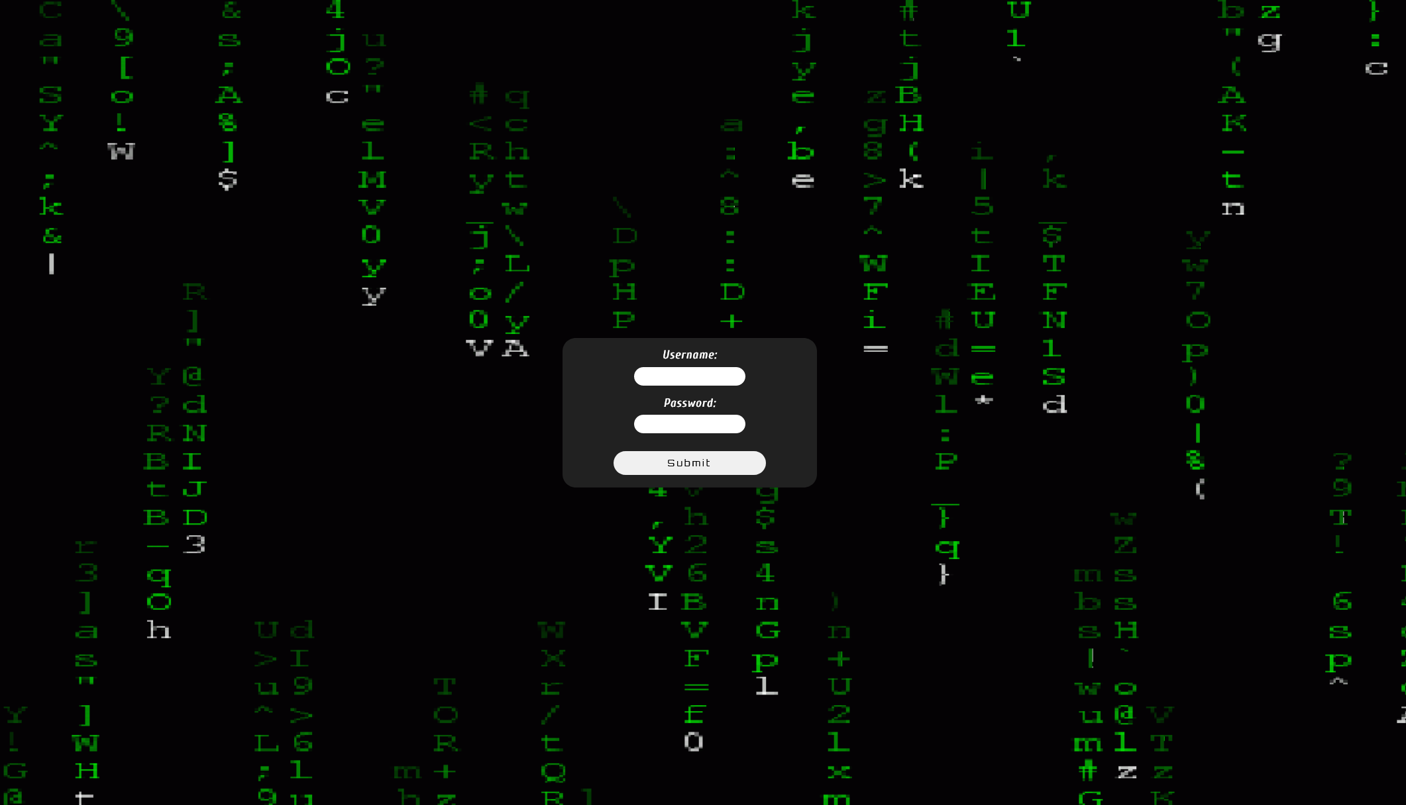
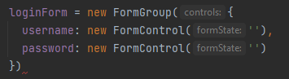
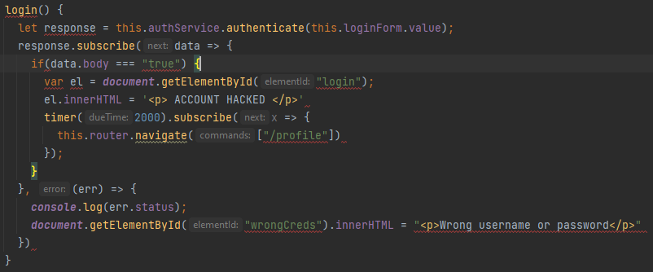
Login Page Front-end
The login page uses a FormGroup for the user input and a service class to send the data to Spring.

Slide 6
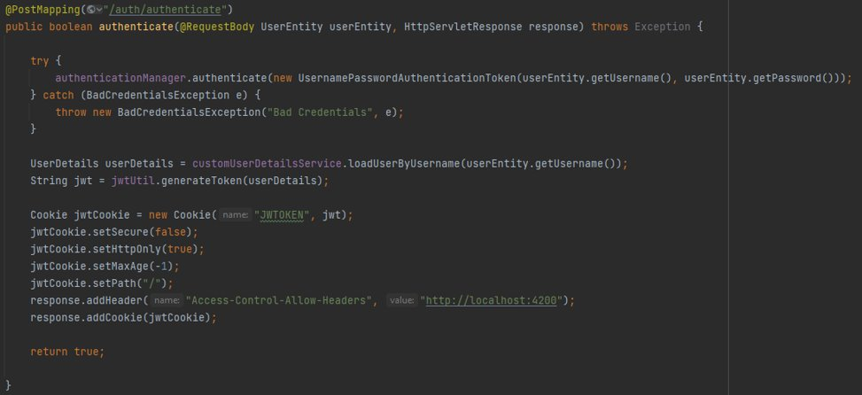
Login Page Back-end
When the front-end sends the username and the password the user entered, the back-end checks them. If they are valid, a Jason Web Token is generated, added to a HTTP-Only Cookie and sent back to the front-end.

Slide 7

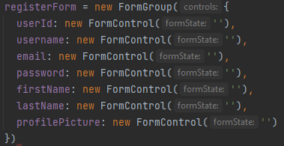
Register Page
The register page uses a FormGroup to get the user input and sends it to the back-end. There, the username is checked to see if there's no other user with the same username, then the account is created and stored in the database.

Slide 8
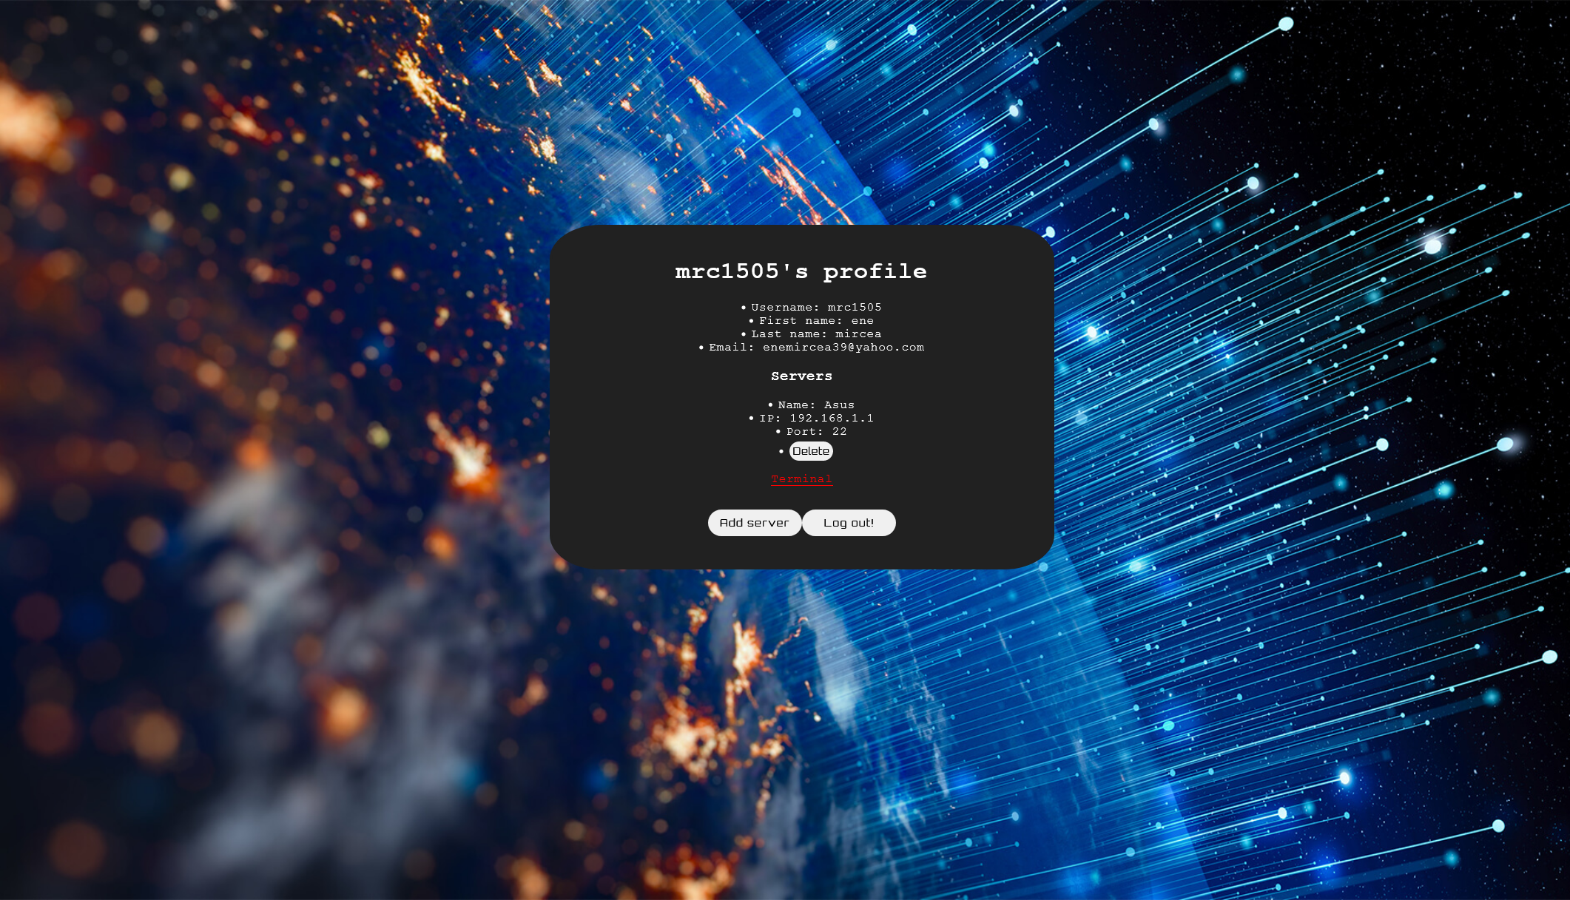
Profile Page

Slide 9
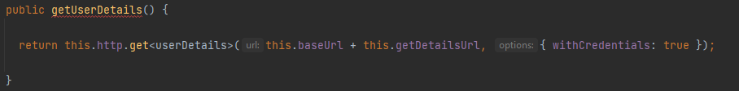
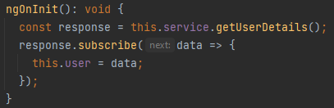
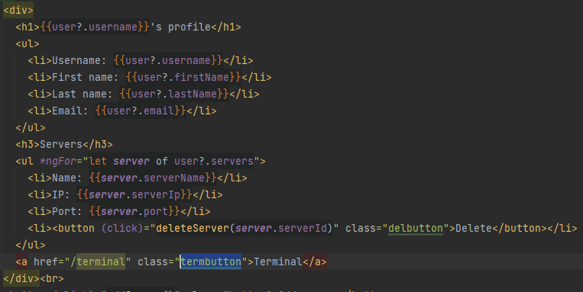
Profile Page Details
On the profile page you can see the user details(ex: username, email, name, etc) and the servers you've added on the account. You also have the option to delete any server, to add another one, to logout, or to go to the Terminal page.
<- restapi.service.ts class
Profile component HTML ->

Slide 10
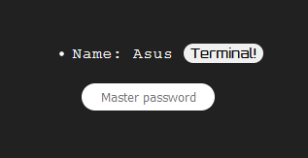
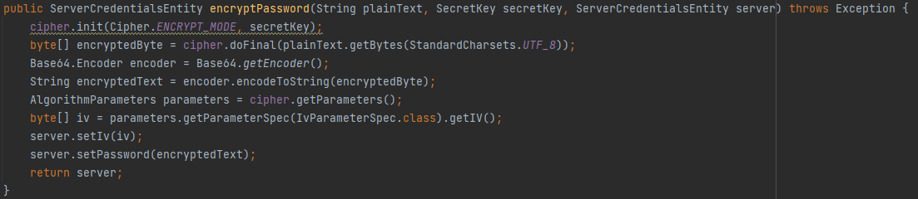
Terminal Page
<- Here you have a list of the servers you added to the account. The idea behind it is that you enter the Master Password and click on the terminal button that corresponds to the server you want to access.
To encrypt the servers passwords, I used a Cipher with the AES/CBC/PKCS5Padding
algorithm. For security purposes, the master password is not stored in the database. The user needs to remember it.

Slide 11
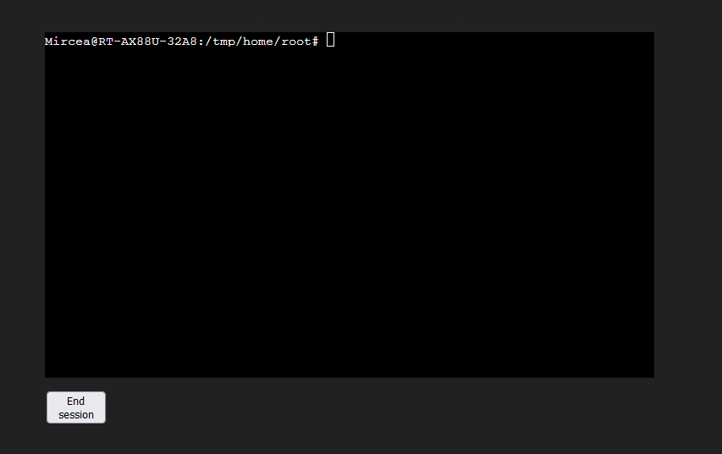
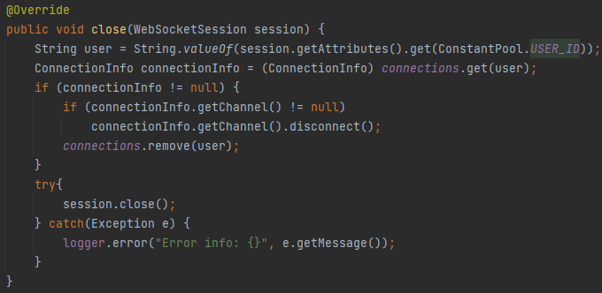
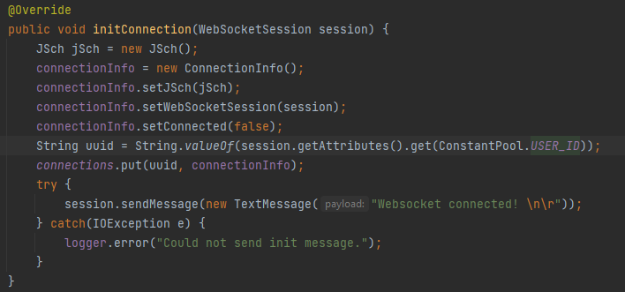
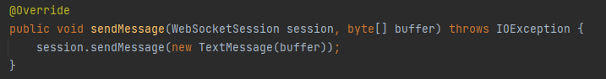
The Terminal
When you connect to the desired server, the back-end acts as a proxy. It gets the data from front-end through WebSockets, seding it further to the server. The SSH connection is made with the JSch library.

Slide 12
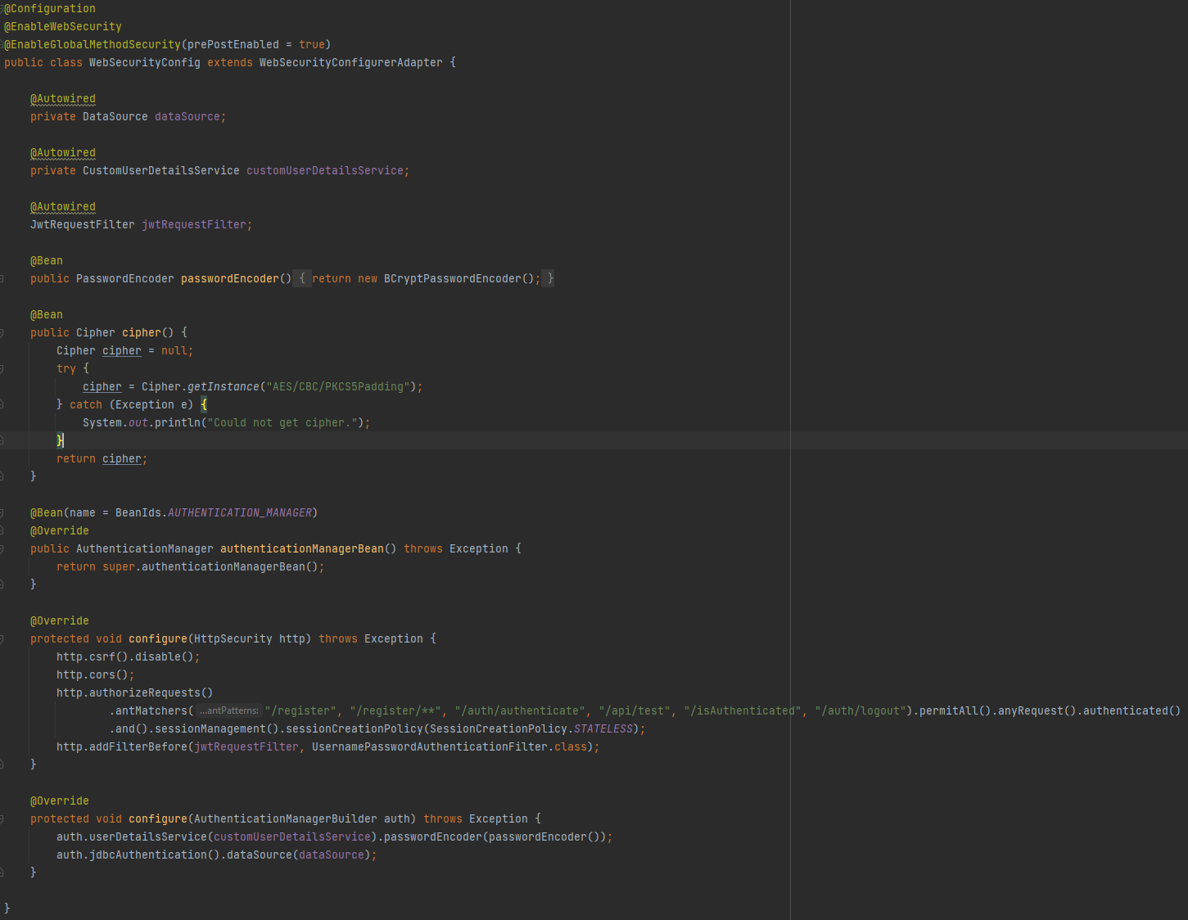
Spring configuration
Here I enabled CORS and set up the antMatchers. Also I've added the JWT filter to check every request and see if the token is valid.

Slide 13
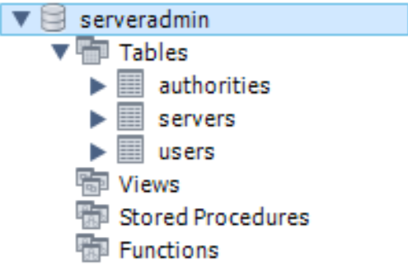
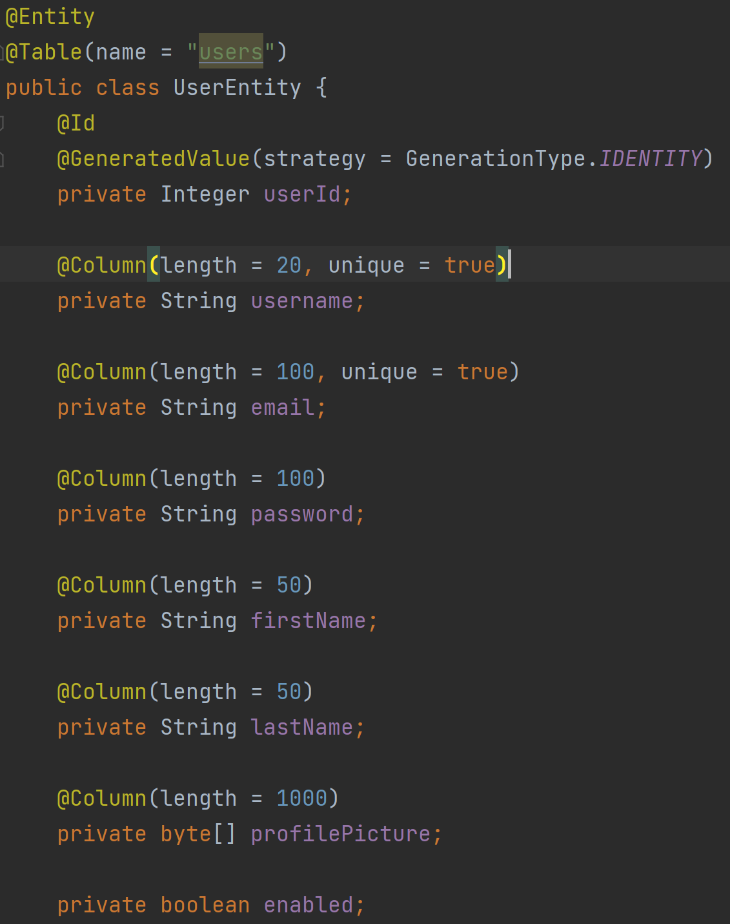
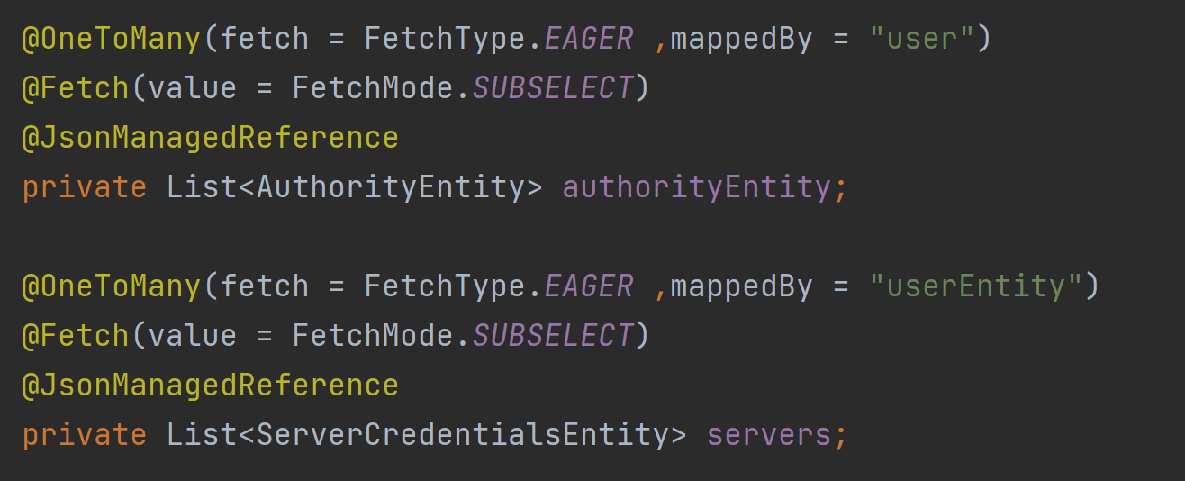
The Database
The database is structured in three tables. One for the user authority(ex: admin, power-user, etc), one for the user details, and one for the SSH details.

Slide 14
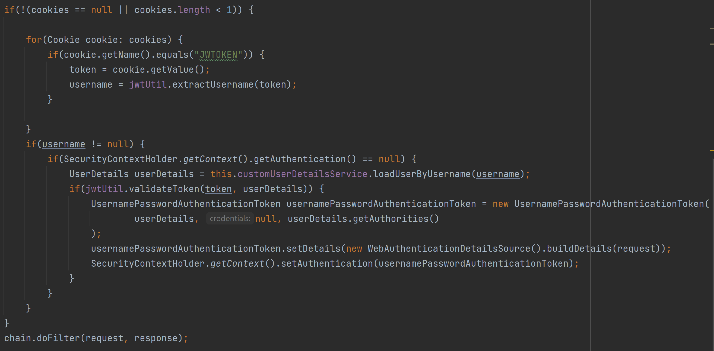
JWT Filter

Slide 15
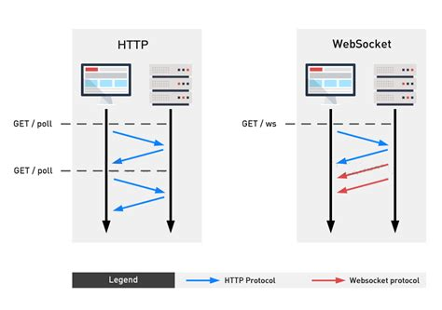
WebSockets
The reason I chose websockets is that this technology allows real-time, two-way communication sessions. Also, it's more efficient over long-polling, consuming less resources.

Slide 16
Future plans
In the near future I want to implement 2FA for a greater security and oAuth so that users can connect much easier with Facebook or Google.
Another idea that I have is to create a forum section where users can create programming tutorials or ask for some advice.
Also, I plan to create an IOS and Android app for the Web SSH project.
Thank you for your time!

